Slide 1
The use of Technology in Ecotourism Sector
Institution Affiliation
Students’ Name
Date of Submission

Slide 2
The use of Technology in Ecotourism Sector
Ecotourism as a sector have recently developed rapidly across the world, and it is also a great contributor to the general development of the economy.
Despite the many benefits it has for the economy of the country, some other challenges affect it, including technological challenge.
However, fundamental developments in the level of technology and their application in this sector can significantly help to the effective management of the challenges facing the ecotourism sector.
This presentation points on the role of Information Communication and Technology to protect the valued ecosystem that forms the basis for ecotourism improvement

Slide 3
Cont.…
The main focus of the use of ICT is based on the development trends of urban areas and the negativities it poses on ecotourism.
This causes the usage of information communication and technology both in rural regions and communities to overcome the challenges.
The ICT sector is very crucial in preserving the ecosystem that has a high value in ecotourism destination by monitoring ecotourism improvements and associated impacts.
The development of technology has led to significant growth and guiding in the ecotourism sector.
This involves the use of technological products and services such as the user experience about HCI such as information architecture, usability in any environment of ecotourism.

Slide 4
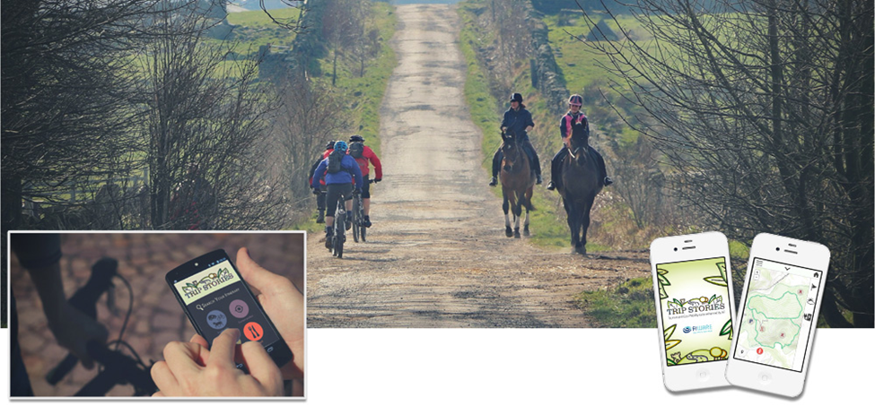
https://wise.town/wp-content/uploads/2018/08/banner_tripstories_2.jpg
The picture above shows the system of integration of city and extra-urban tourism with the city’s sensors and its open data.
It is a set of services for ecotourism and mobility to support municipalities in the improvement of tourist routes as well as ecotourism.

Slide 5
Cont.…
The use of Information Technology (IT) is much crucial in ecotourism. In most cases, ecotourism involves services that are not tangible that can be inspected and boosted with the development of technology.
Therefore, technology offers open information concerning tourism and allows most of ecotourism service providers to receive the information they require to improve their services.
Geographic Information System (GIS), is a technological aspect that is widely used in various field, including ecotourism sector.
The skill of GIS is essential as it is used in tourism as a decision-supporting tool for tourism planning, impact assessment, and evaluation, visitor flow management, as well as the selection of tourism site.
In addition to GIS, GPS technology in ecotourism is used in guiding. The appropriate application of these two technologies to ecotourism can be a good user experience for information searching by tourists and service providers.

Slide 6
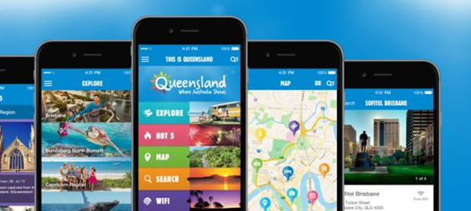
https://www.ecotourism.org.au/assets/Uploads/_resampled/SetRatioSize900600-homepage-banner-thisisqld-1.jpg
TEQ's. This Is Queensland App Updates. This application can offer various information to travelers in combination with top facilities and activities, events as well as local accommodation and attractions.
This has been possible through the use of iBeacons, a type of Near Field Communication and makes use of a new location-based technology which inevitably transfers essential information to the app users.

Slide 7
References
CHENG, Z. H., & ZHANG, J. T. (2001). THE ORIGINATION AND RESEARCH DEVELOPMENT OF ECOTOURISM [J]. Economic Geography, 1.
Hai-ling, G., & Liang-qiang, W. (2011). A GIS-based approach for information management in ecotourism region. Procedia Engineering, 15, 1988-1992.
Jiaming, L. (1998). Advances in ecotourism and its planning research.[J]. CHINESE JOURNAL OF APPLIED ECOLOGY, 3.
Zimmermann, B. (2019, May). The Science of Ecotourism. In PROCEEDINGS The 4th International Conference on Basic Sciences 2018: The Development of Sciences and Technology in Improving Natural and Cultural Resources (p. 2). Faculty of Mathematics and Natural Sciences University as Pattimura Ambon.

